Slide 1
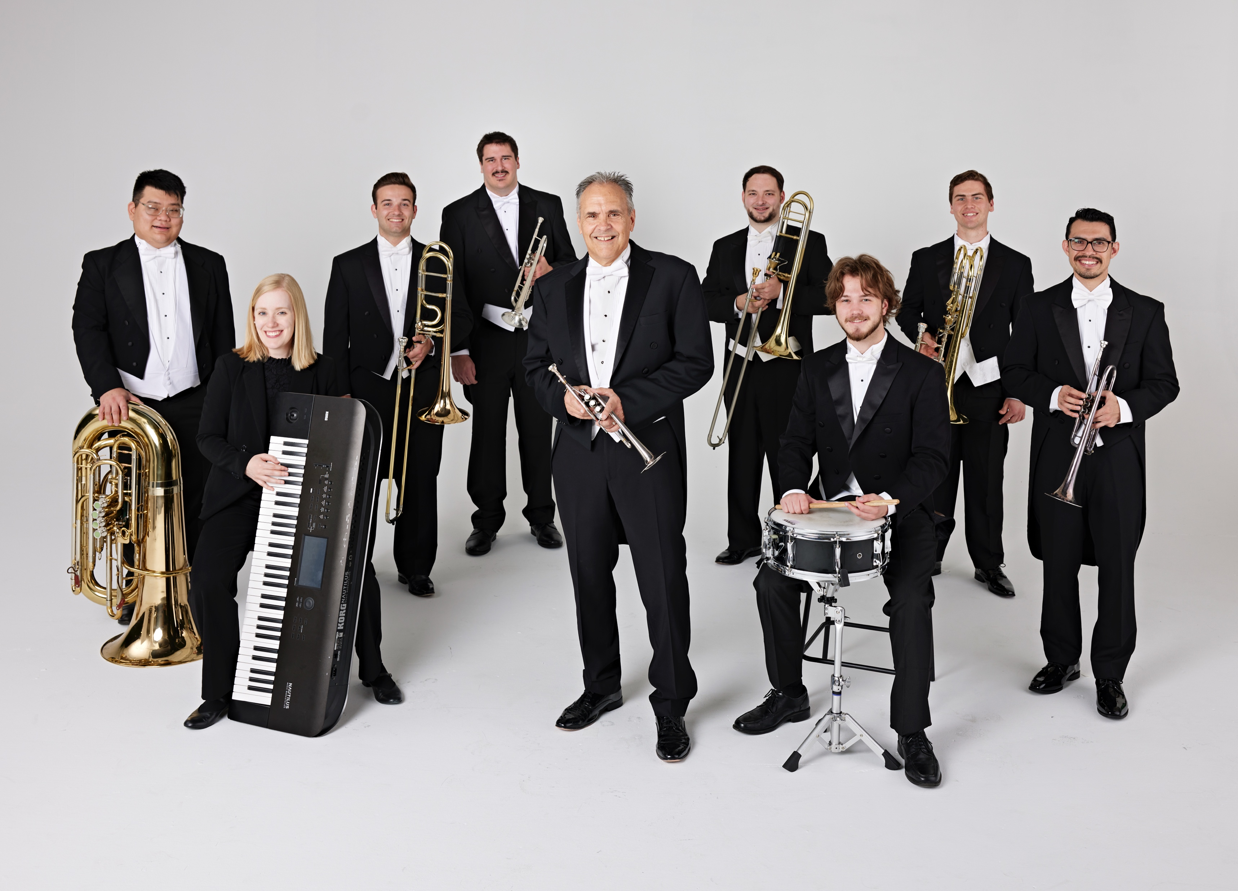

Tim Zimmerman &
The King’s Brass
Notes:
Please advance to the next slide as soon as you hear music.

Slide 2

Fanfare for the Common Man
Aaron Copland / Arr. Phil Norris
Notes:
Move to the next slide when Tim says, “…and put their trust in Him.”

Slide 3
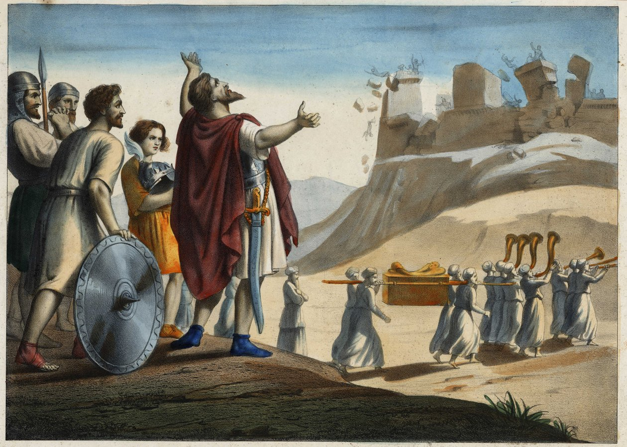
Joshua
Spiritual / Arr. Dan Marvin
Notes:
Move to next blank slide when the audience applauds at the end.

Slide 4

Come, Thou Fount of Every Blessing
John Wyeth / Arr. Dan Marvin
Notes:
Move to next blank slide when the audience applauds at the end.

Slide 5
Notes:
Move to Armed Forces Salute when Tim talks about wanting to honor veterans

Slide 6
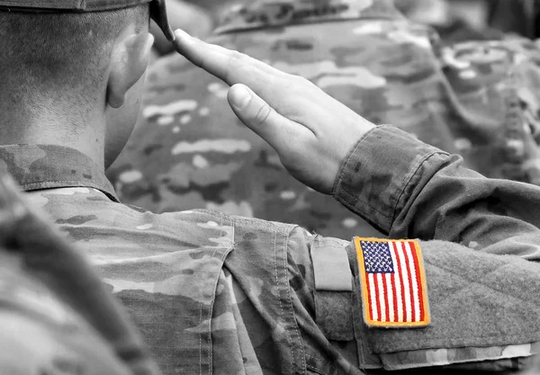
Armed Forces Salute
Bob Lowden / Arr. Ardis Faber
Army, Coast Guard, Marine Corps, Air Force, Navy
Please stand, as you are able, when you hear your service band song,
so we can acknowledge you.
Notes:
Nothing will be said after this song is over. Move to next slide when you hear applause.

Slide 7
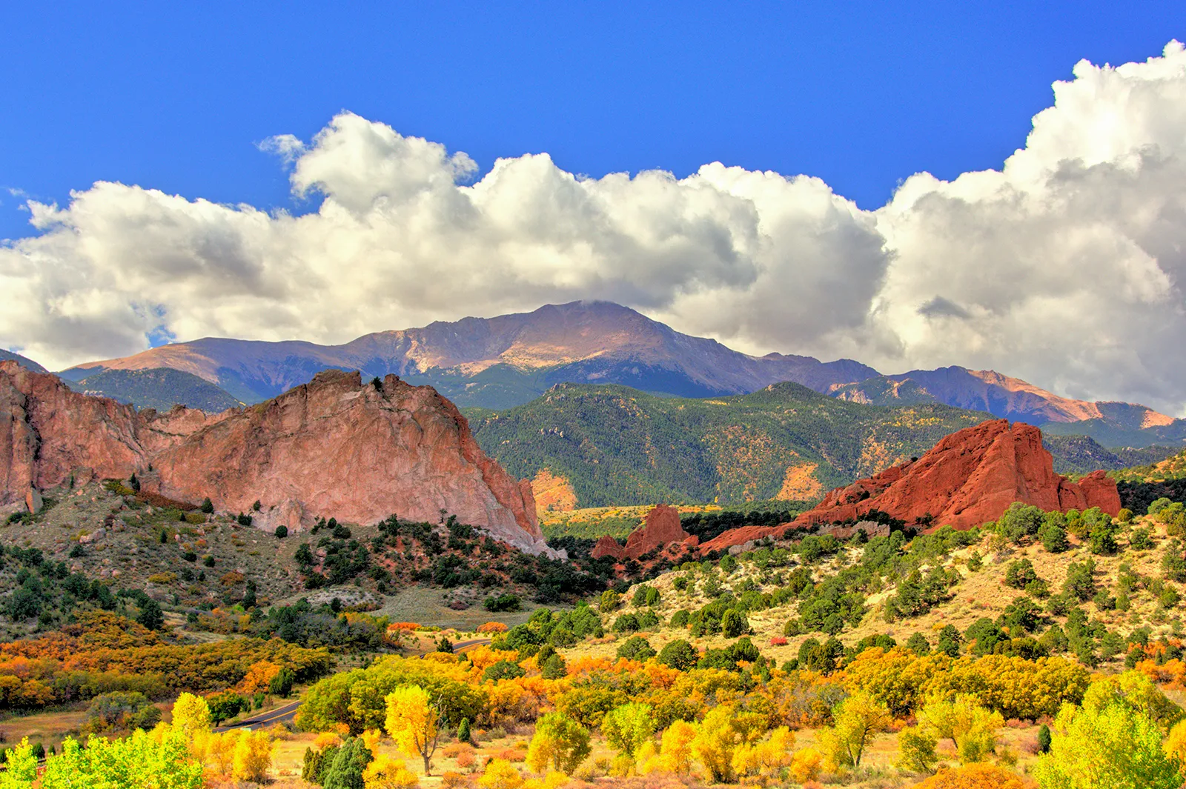
America, the Beautiful
Samuel Ward / Arr. Dan Marvin
Notes:
Move to next slide when Tim finishes talking.

Slide 8
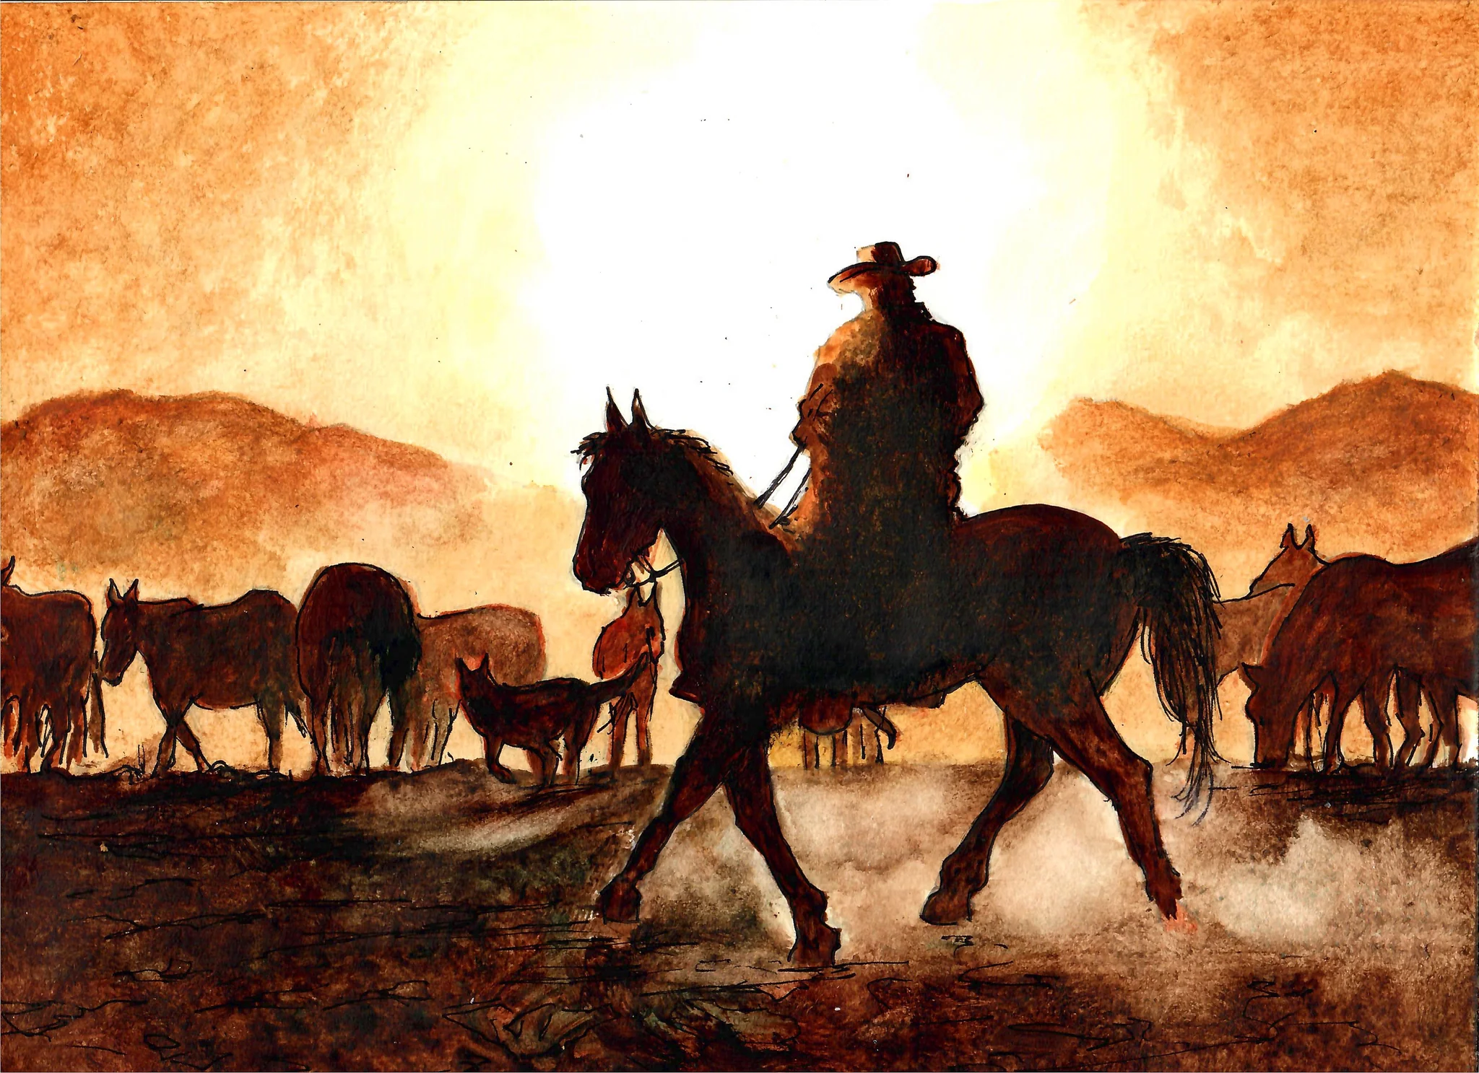
Hoe-Down from Rodeo
Aaron Copland / Arr. Doug Warner
Notes:
Move to next slide after the applause is done.

Slide 9
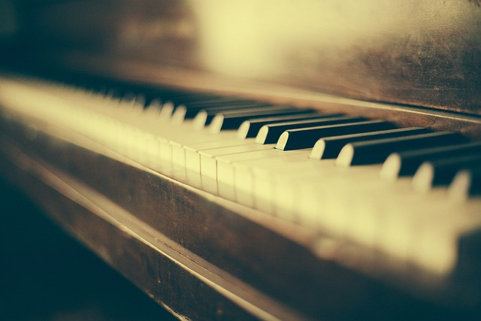
The Lord’s Prayer
Albert Hay Malotte / Arr. Lorie Line
Notes:
Move to next slide when the applause is done.

Slide 10
The Great Gate of Kiev from Pictures at an Exhibition
Modest Mussorgsky
Notes:
Move to next slide when the applause is done.

Slide 11
Notes:
Move to next slide when the keyboard starts to play.

Slide 12
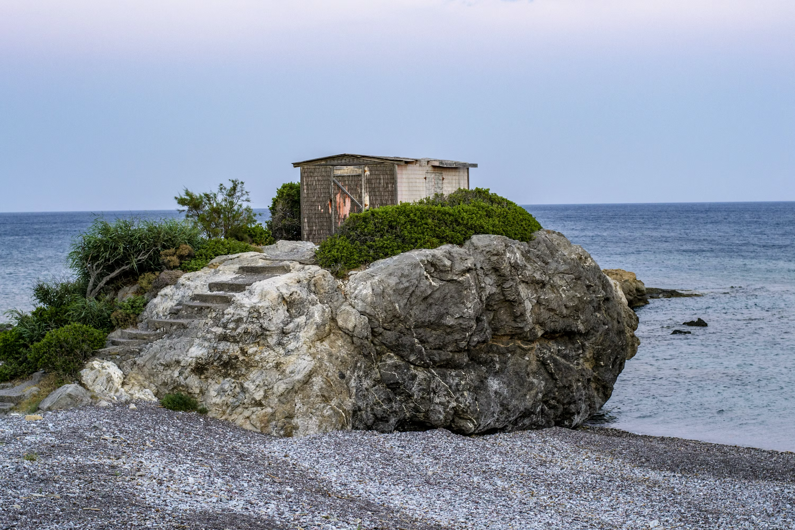
The Wise Man Built His House – Story for Kids
Traditional / Arr. Tim Zimmerman
Notes:
Move to the next slide when the applause is done.

Slide 13

American Salute
(When Johnny Comes Marching)
Morton Gould / Arr. A. Faber
Notes:
Move to next slide after the applause. Nothing will be said.

Slide 14
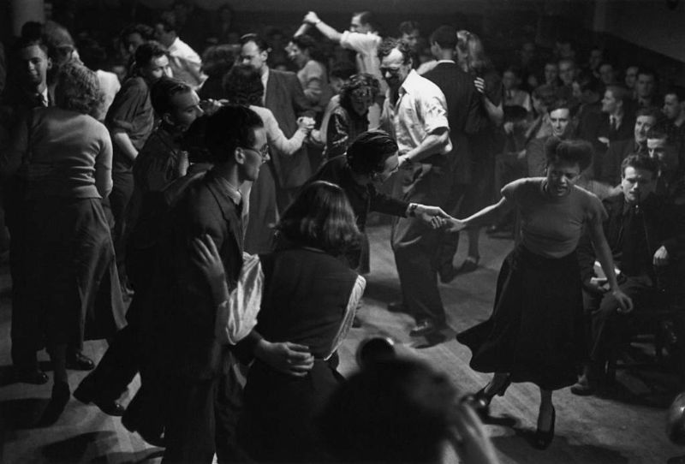
Sing, Sing, Sing
Louis Prima / Arr. Jason Webb
Notes:
Move to next slide after the applause. Nothing will be said.

Slide 15

God Bless The U.S.A.
Lee Greenwood / Arr. Lisa Nelson
Notes:
Move to next slide after the applause is done.

Slide 16
Notes:
Cue the next slide when the King’s Brass member says, “Crown Him with Many Crowns.”

Slide 17
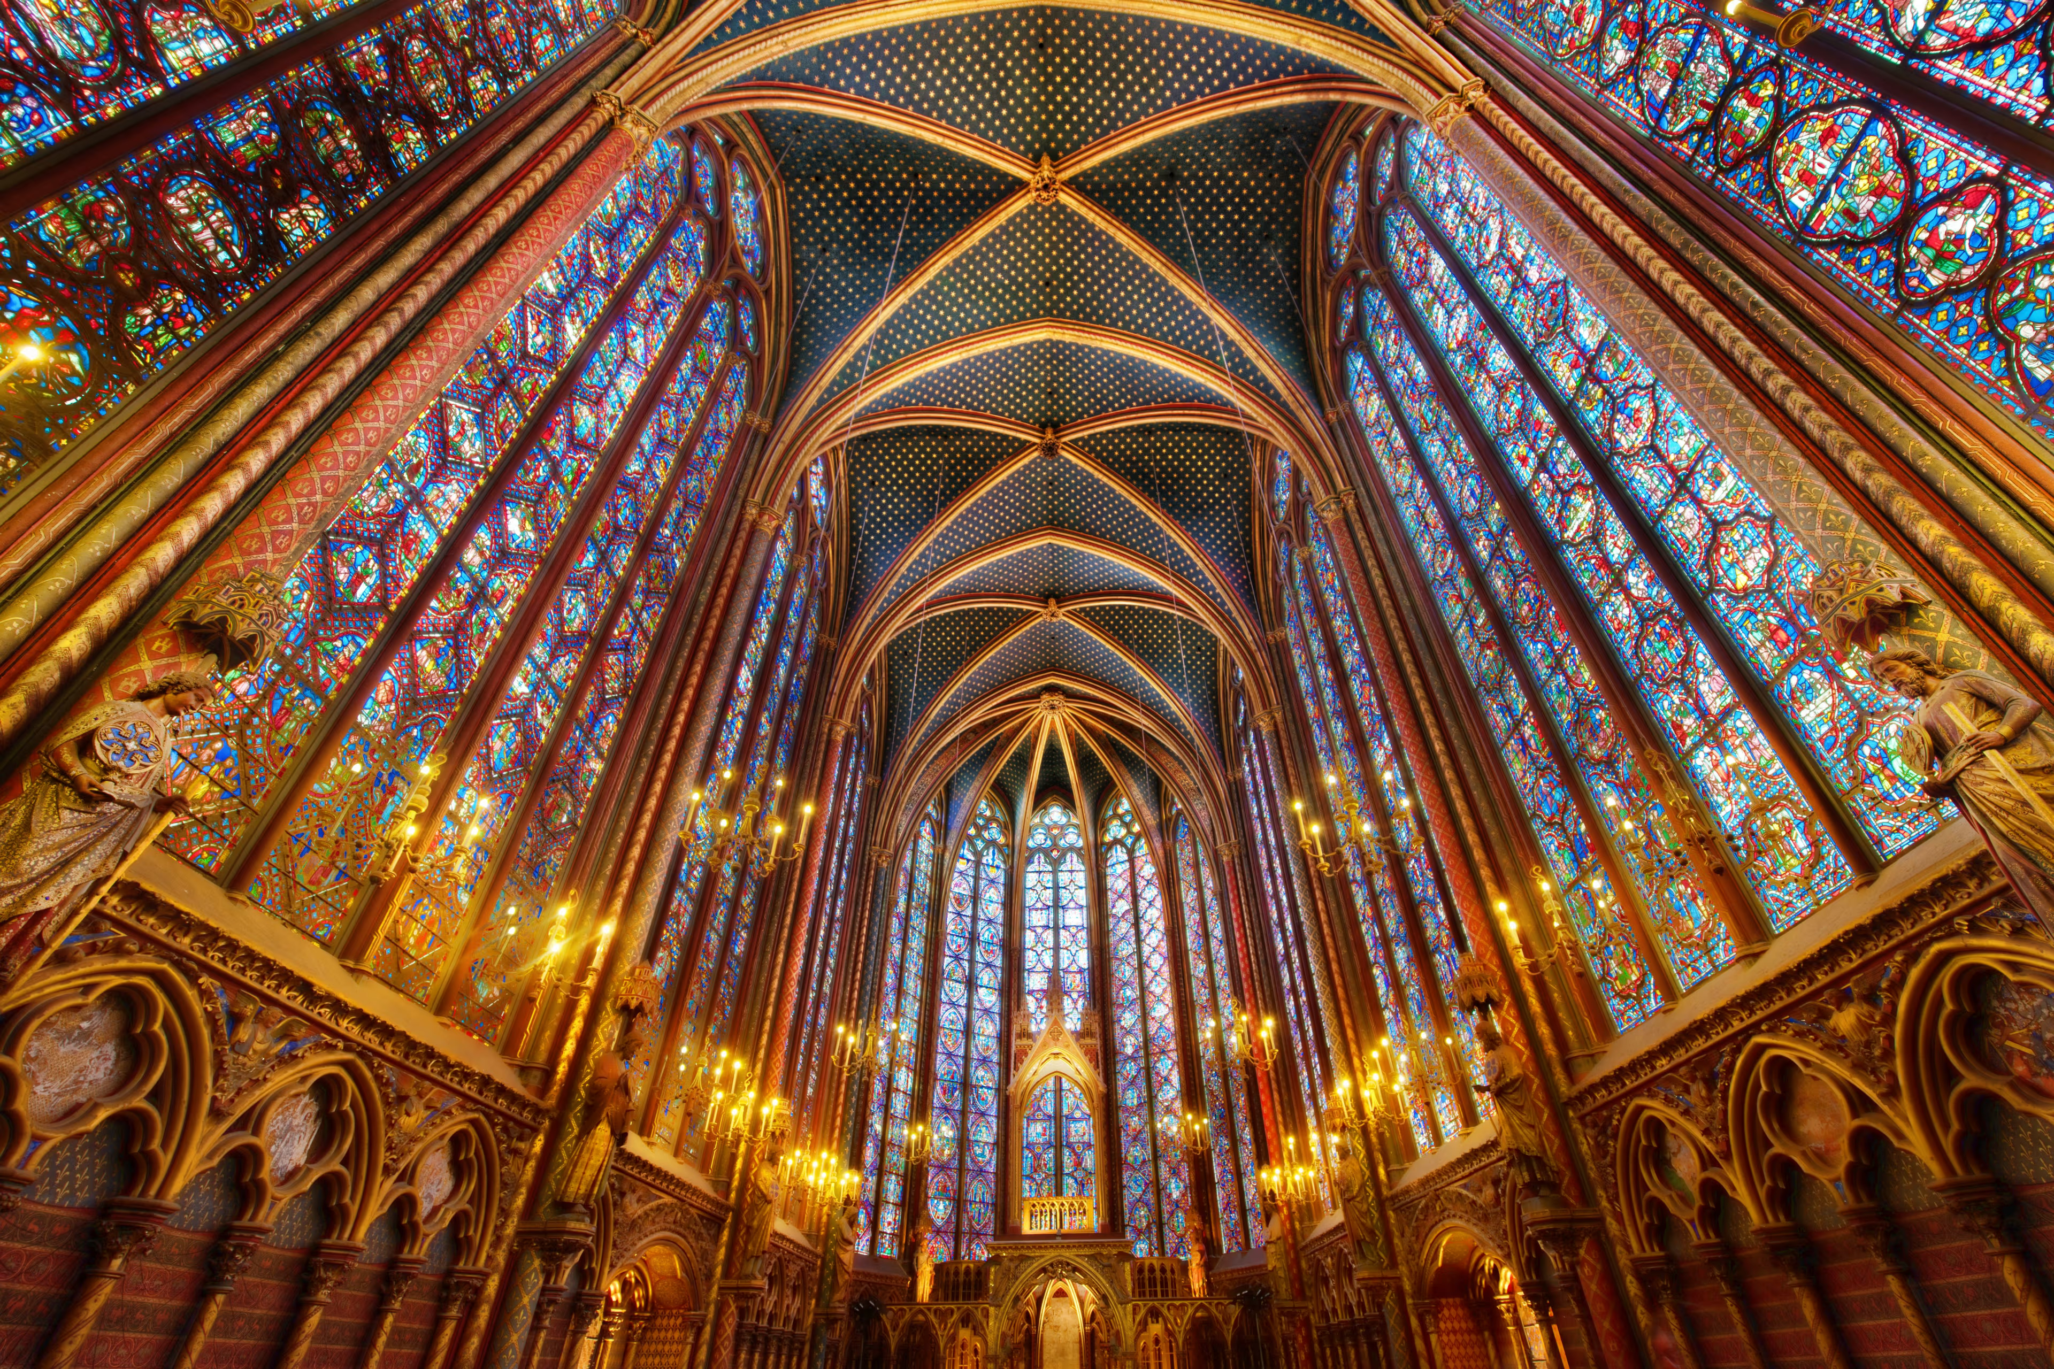
Crown Him with Many Crowns
George Elvey / Arr. Marvin & Zimmerman
Notes:
Please do not start the lyrics when you hear the music. Wait until you hear Tim Zimmerman say loudly on the microphone, “PLEASE STAND and join us in singing…” before showing the first lyric slide.

Slide 18
Crown Him with many crowns; The lamb upon His throne

Slide 19
Hark! how the heav’nly anthem drowns
All music but its own!

Slide 20
Awake, my soul, and sing
Of Him who died for thee,

Slide 21
And hail Him as thy matchless King
Thro’ all eternity.

Slide 22
Crown Him the Lord of love!
Behold His hands and side

Slide 23
Rich wounds, yet visible above,
In beauty glorified.

Slide 24
All hail, Redeemer, hail!
For Thou hast died for me;

Slide 25
Thy praise and glory shall not fail,
Thro’out eternity.

Slide 26
Crown Him the Lord of life!
Who triumphed o’er the grave;

Slide 27
Who rose victorious in the strife
For those He came to save.

Slide 28
His glories now we sing,
Who died and rose on high,

Slide 29
Who died eternal life to bring,
And lives that death may die.

Slide 30
Crown Him the Lord of heav’n!
One with the Father known,

Slide 31
One with the Spirit thro’ Him giv’n
From yonder glorious throne.

Slide 32
To Thee be endless praise,
For Thou for us hast died.

Slide 33
Be Thou, O Lord, thro’ endless days
Adored and magnified!
© Public Domain
Notes:
Move to next blank picture slide after the last word is sung

Slide 34
Notes:
Move to next slide when the next song starts to play

Slide 35
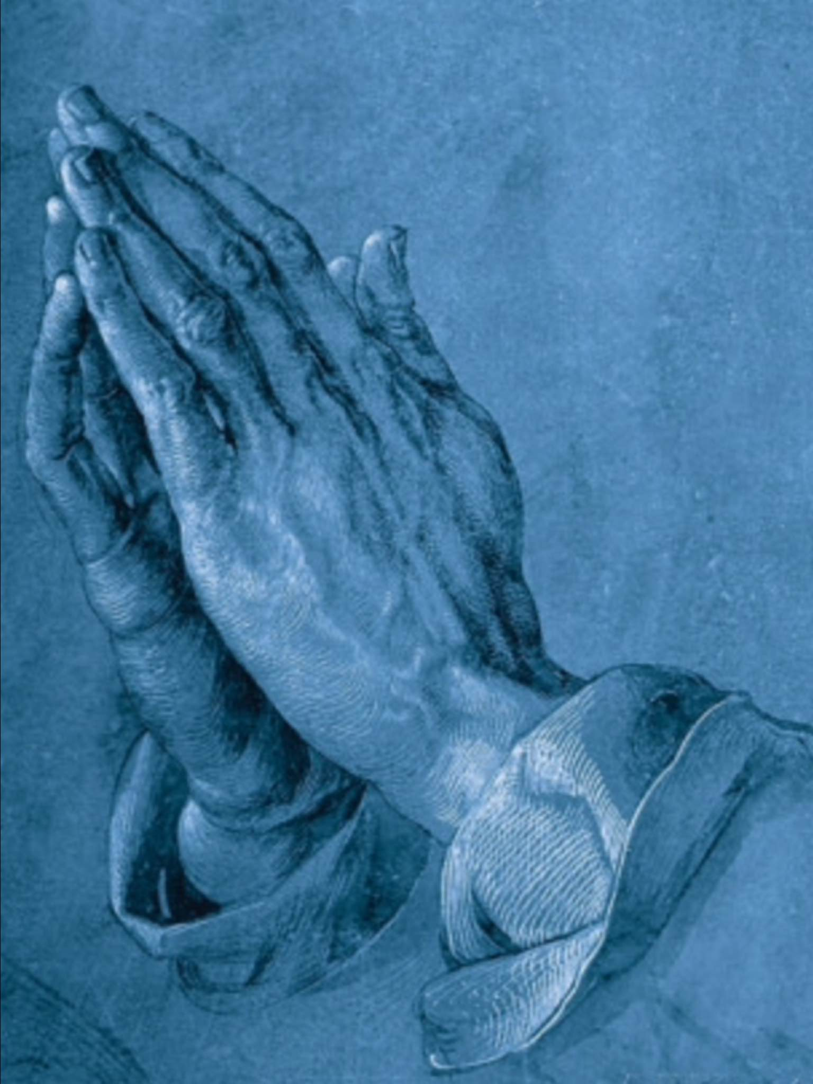
What A Friend We Have in Jesus
Charles Converse / Arr. Marvin & Zimmerman
Notes:
Move to the next slide when Tim starts talking again.

Slide 36
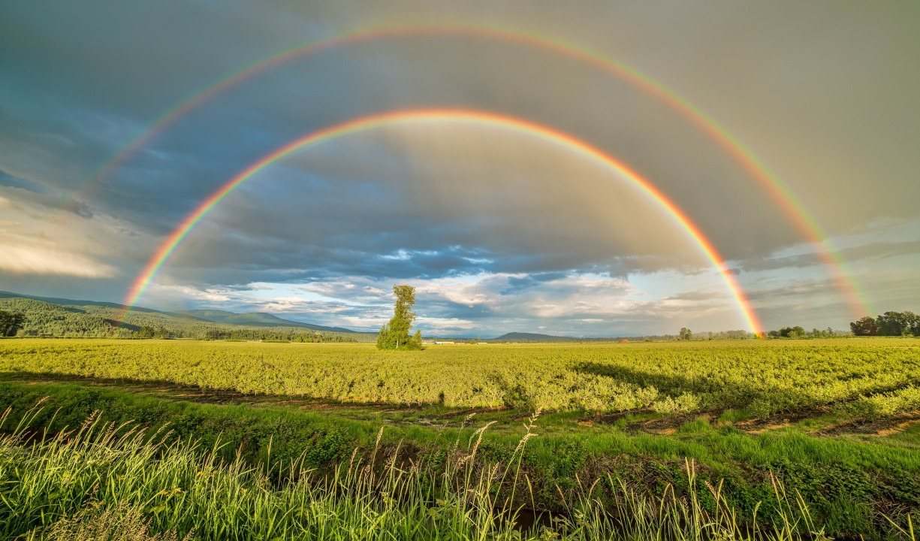
What A Wonderful World
B. Thiele and G. Weiss / Arr. Lisa Nelson
Notes:
Move to next slide when Tim starts talking again.

Slide 37
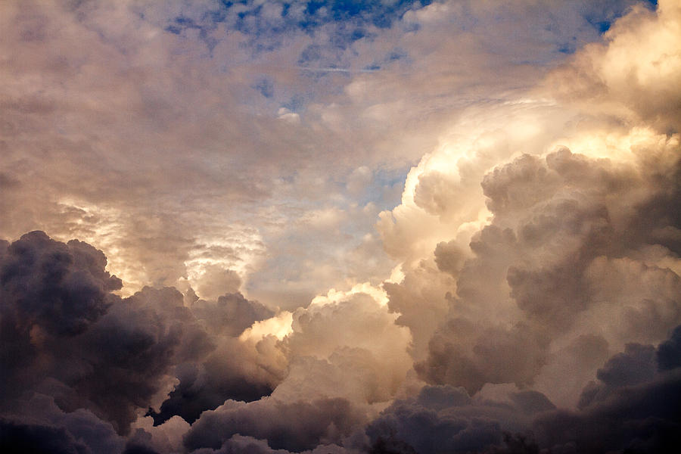
God of Our Fathers
George Warren / Arr. Tim Zimmerman
Notes:
Move to next slide after the applause.

Slide 38
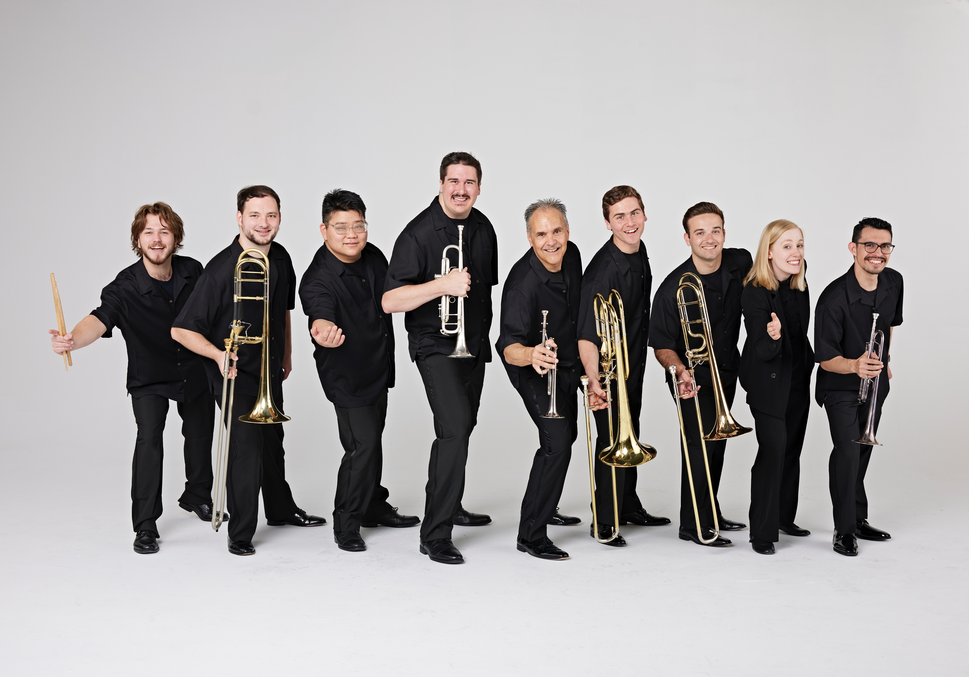
Intermission

Slide 39
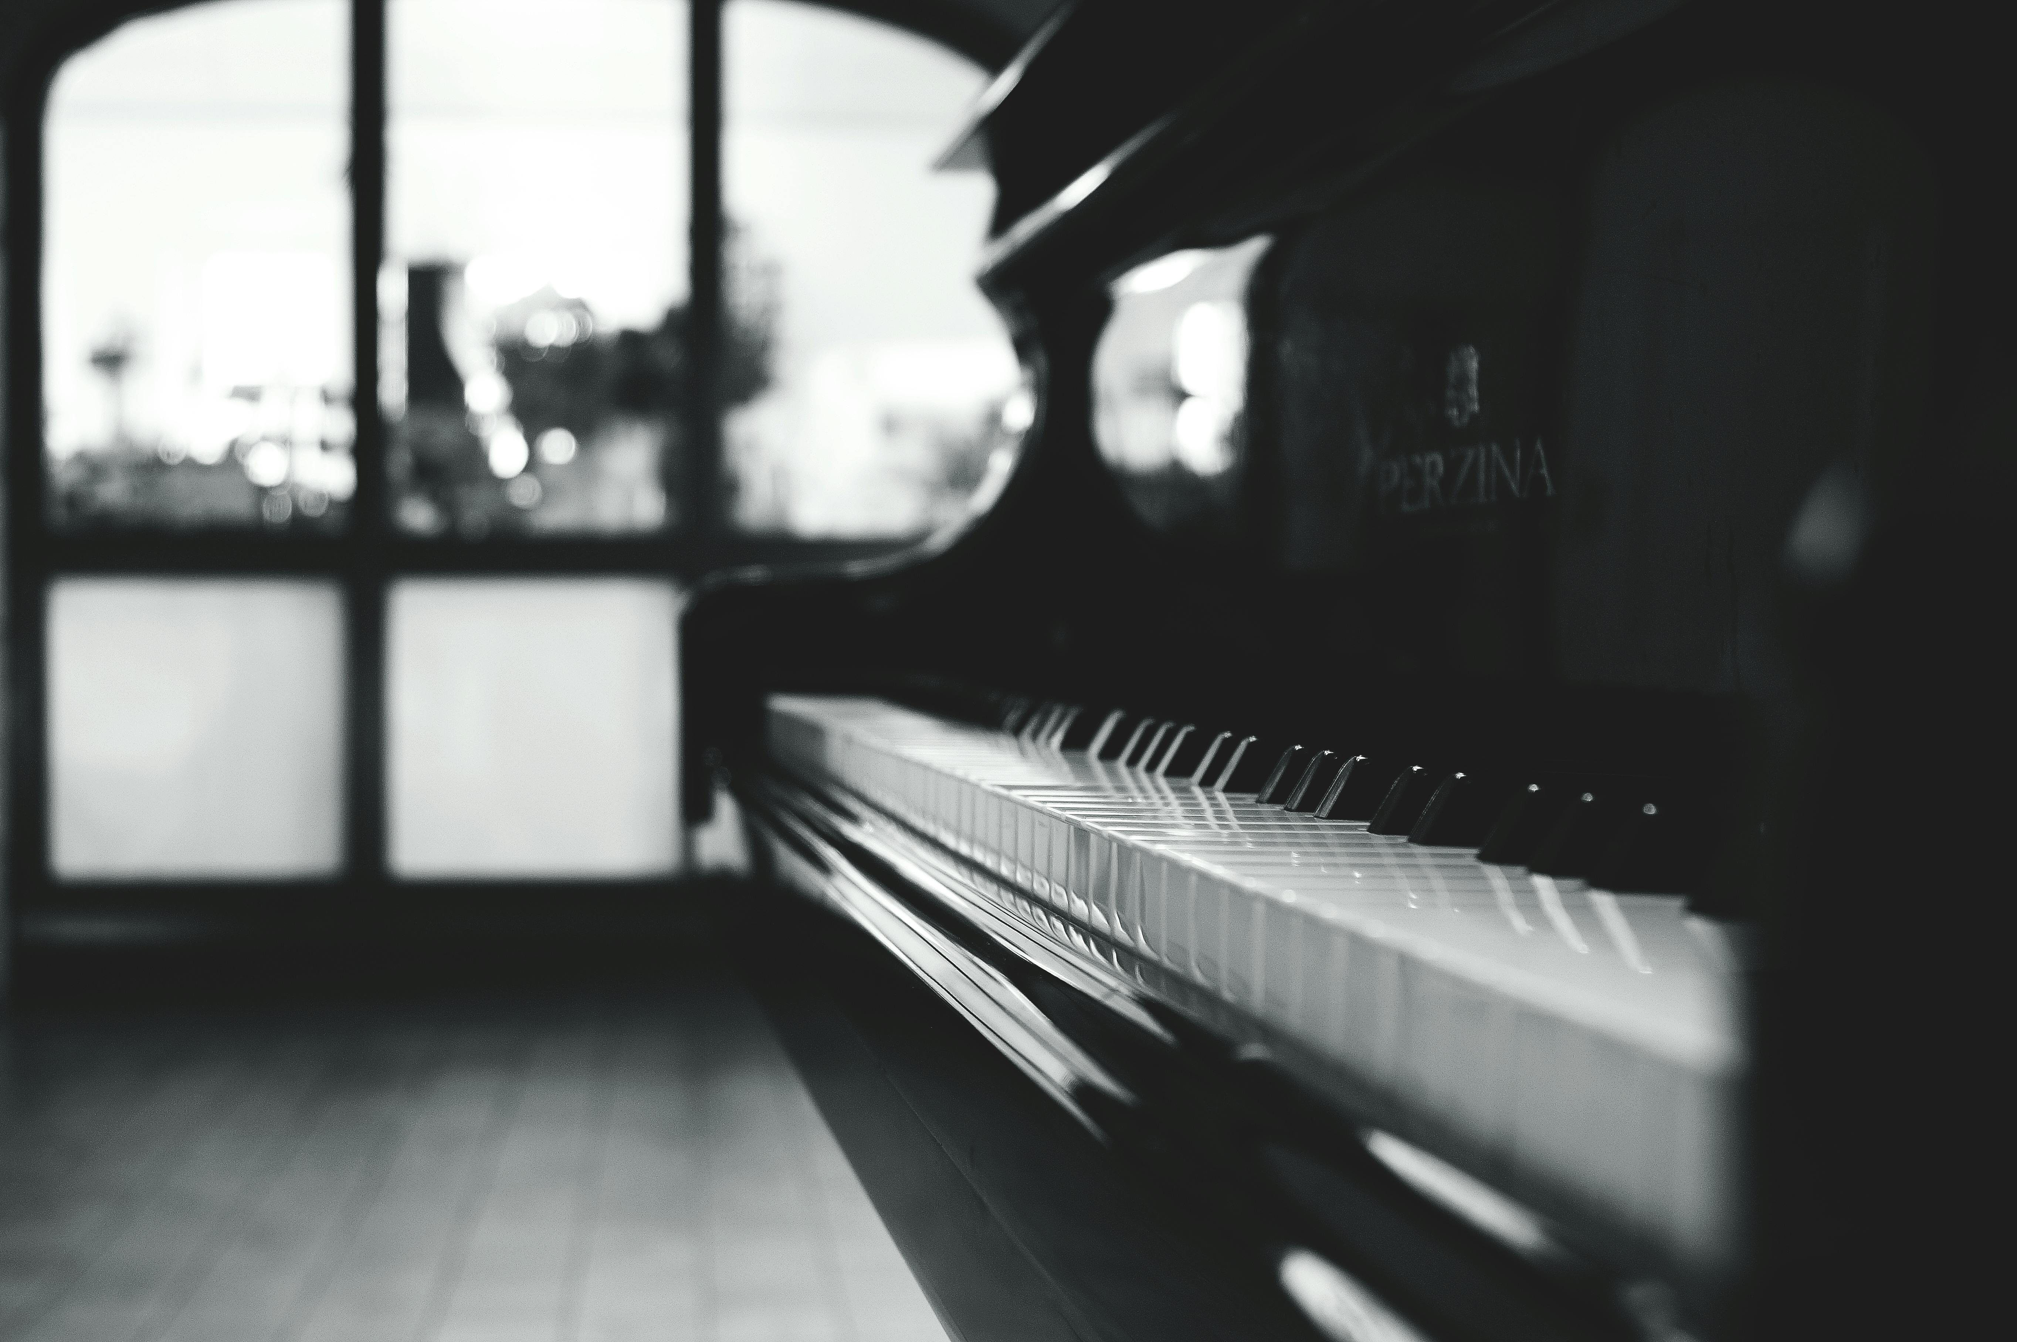
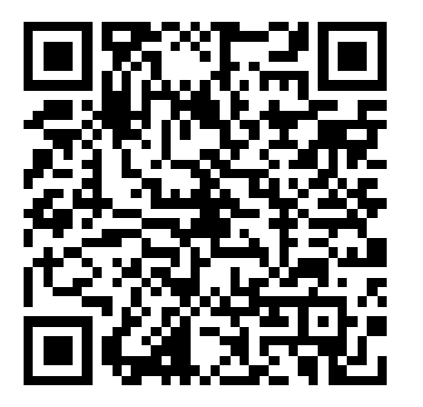
Sonata No. 8 in C minor “Pathétique”
II. Adagio Cantabile
Ludwig Van Beethoven
You may give online to the King’s Brass by scanning the QR code on the right.

Slide 40
Sonata No. 8 in C minor “Pathétique”
II. Adagio Cantabile
Ludwig Van Beethoven

Slide 41
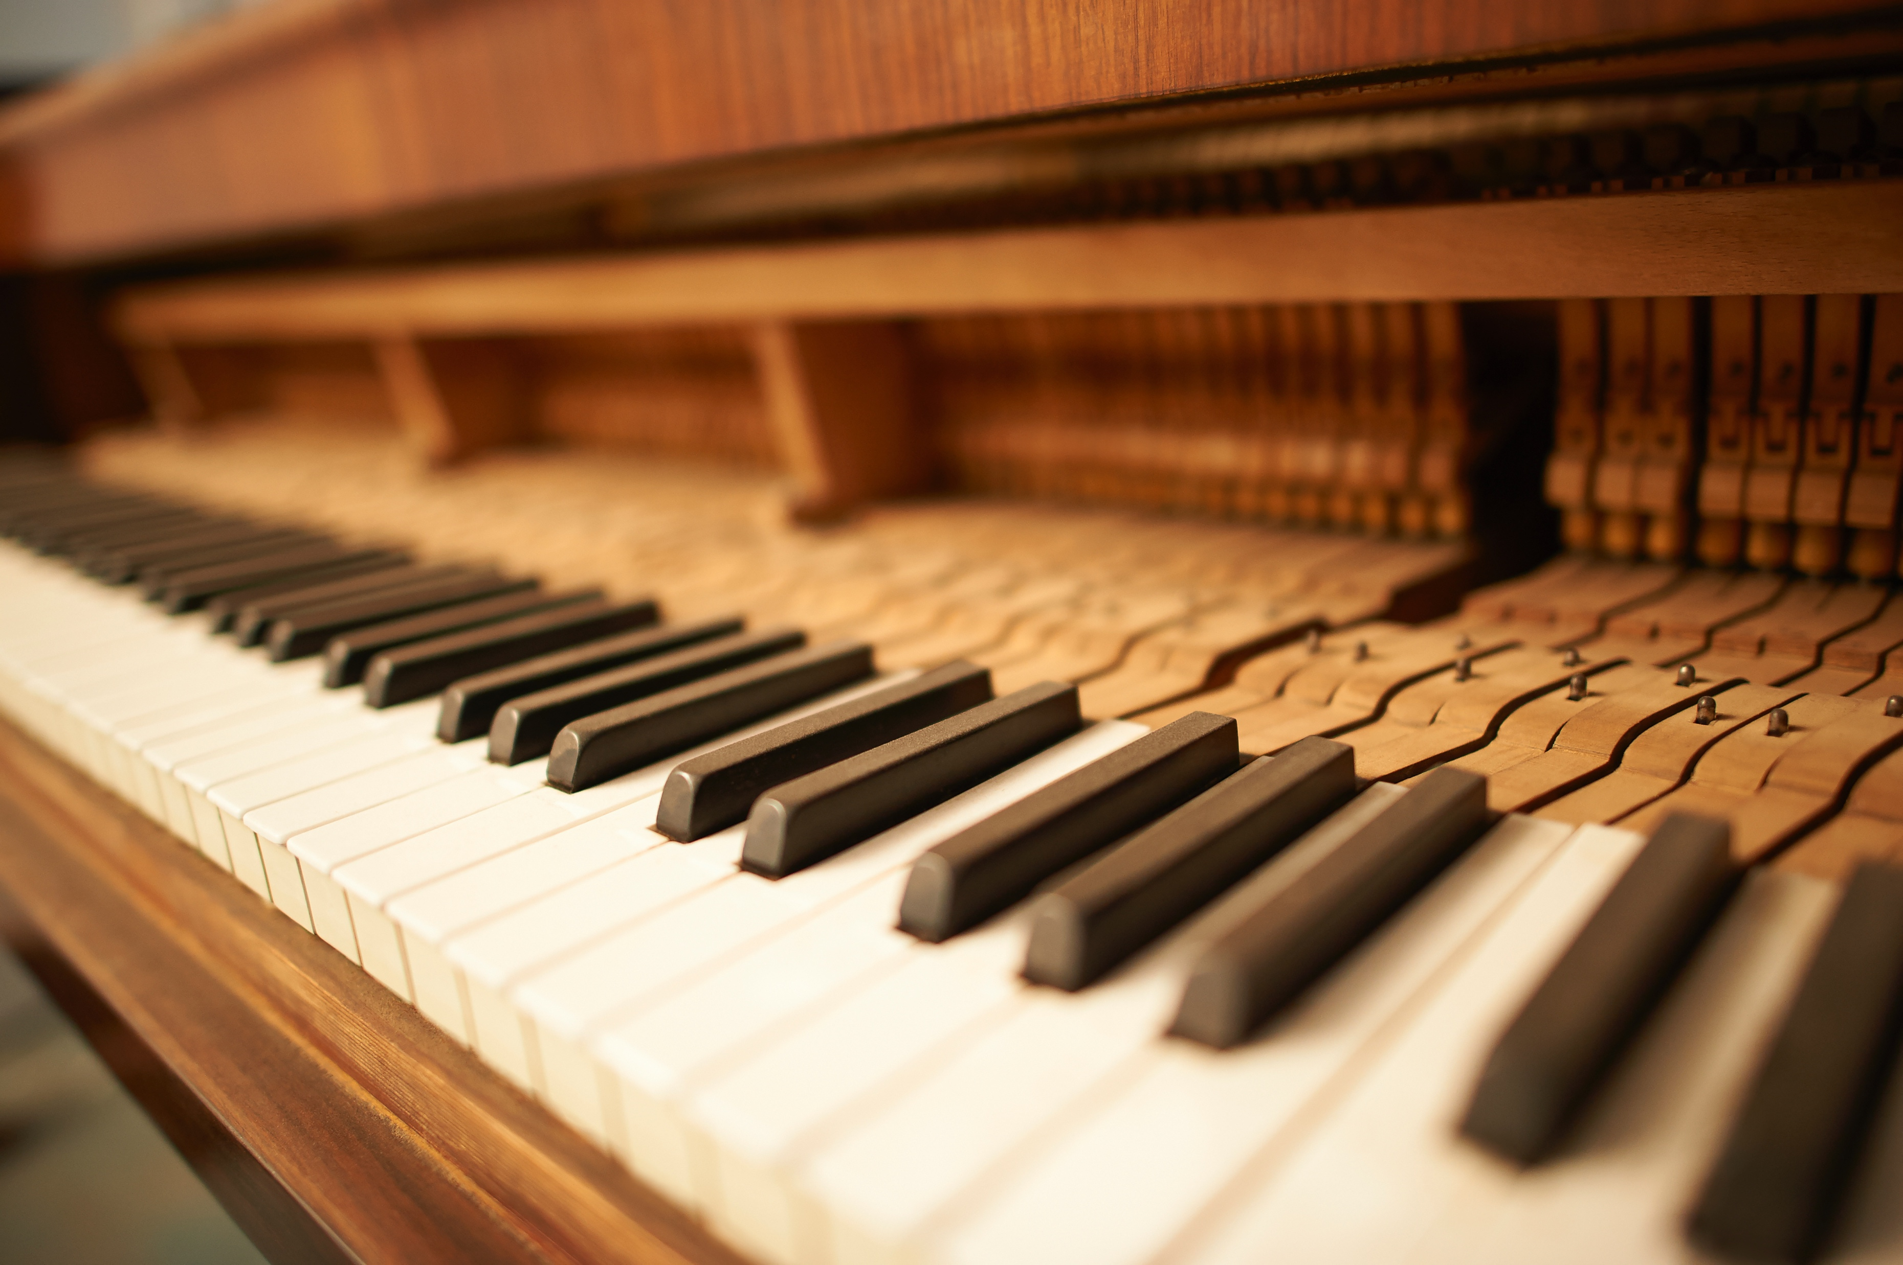
It is Well
Philip Bliss / Arr. Lorie Line
You may give online to the King’s Brass by scanning the QR code on the right.

Slide 42
It is Well
Philip Bliss / Arr. Lorie Line

Slide 43
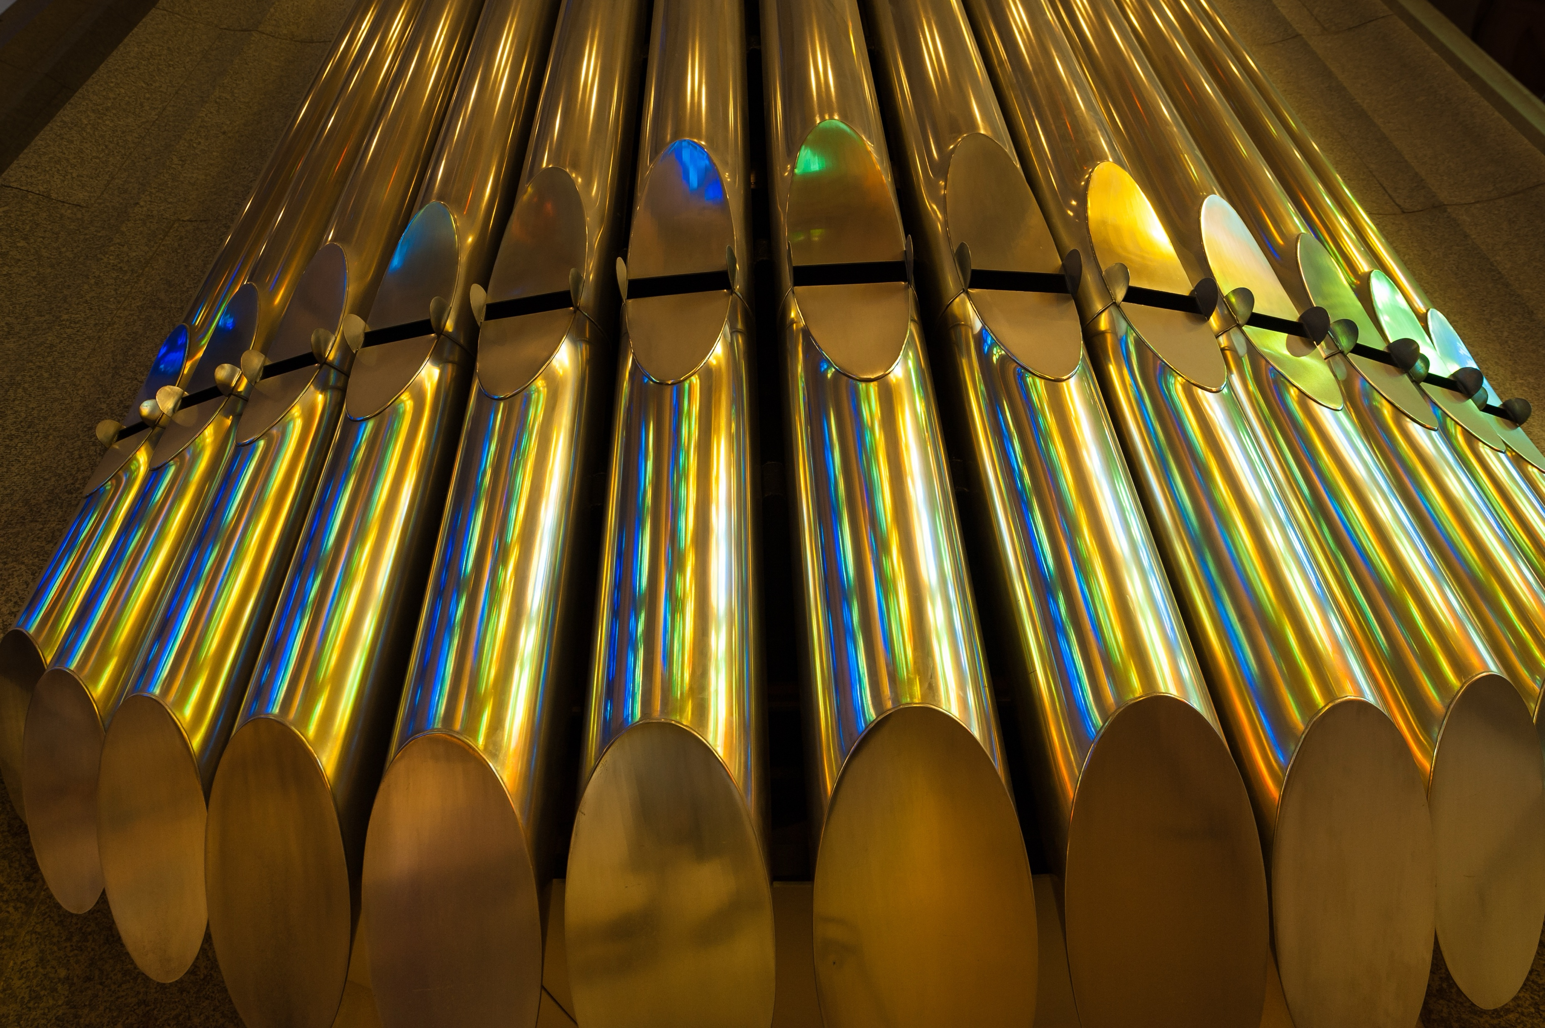
Toccata from the Fifth Symphony (Organ Solo)
C.M. Widor
You may give online to the King’s Brass by scanning the QR code on the right.

Slide 44
Toccata from the Fifth Symphony (Organ Solo)
C.M. Widor

Slide 45
Galeries Ancien (Organ Solo)
Dennis Janzer

Slide 46
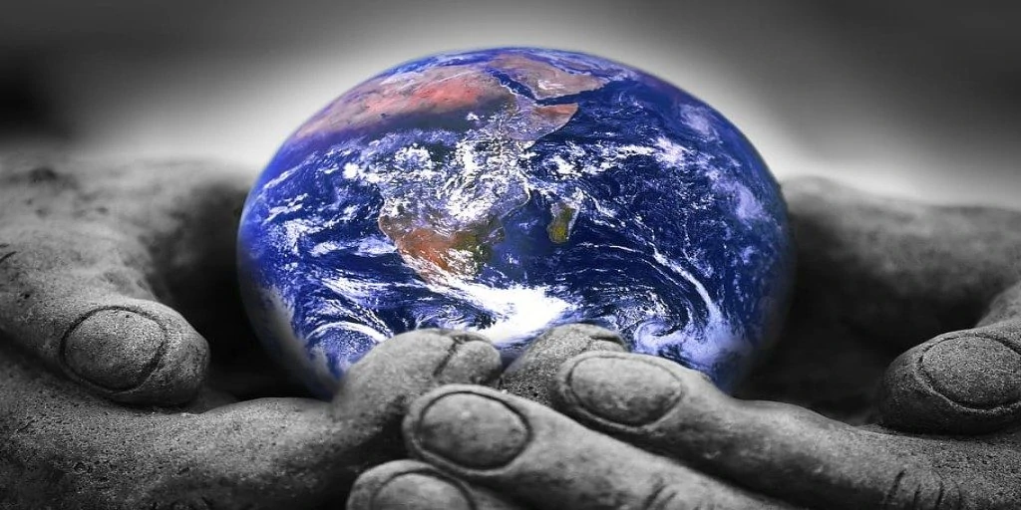
He’s Got the Whole World in His Hand
Spiritual / Arr. Tim Zimmerman
Notes:
There are two halves: a slow first, and faster second. The audience will clap at the end of the slow one, thinking it is over. Do not change slides. WAIT until the faster half is done.

Slide 47
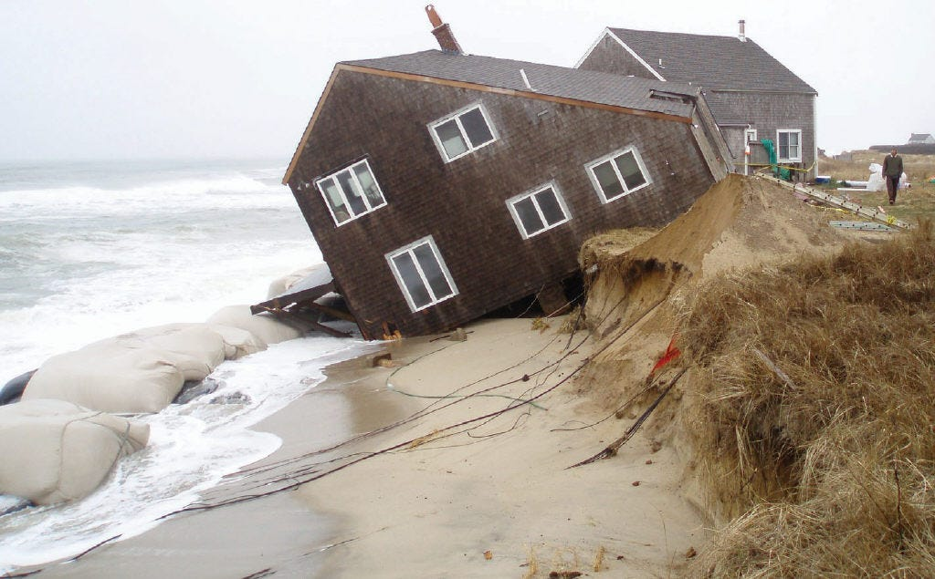
Group Parable – House On a Rock
John Duckworth
Notes:
When music starts at the end of the skit, move to the next slide.

Slide 48

How Great Thou Art
Stuart Hine / Arr. Marvin & Zimmerman
Notes:
Please do not show lyrics when you hear music. WAIT until Tim says loudly “Please STAND and join us in singing…” before showing lyrics on the next slide.

Slide 49
O Lord my God, when I in awesome wonder
Consider all the worlds Thy hands have made,

Slide 50
I see the stars, I hear the rolling thunder
Thy pow’r thro’out the universe displayed.

Slide 51
Then sings my soul, my Savior God, to Thee;
How great Thou art! How great Thou art!

Slide 52
Then sings my soul, my Savior God, to Thee;
How great Thou art! How great Thou art!

Slide 53
And when I think that God, His son not sparing,
Sent Him to die, I scarce can take it in;

Slide 54
That on the cross, my burden gladly bearing,
He bled and died to take away my sin.

Slide 55
Then sings my soul, my Savior God, to Thee;
How great Thou art! How great Thou art!

Slide 56
Then sings my soul, my Savior God, to Thee;
How great Thou art! How great Thou art!

Slide 57
When Christ shall come with shout of acclamation
And take me home, what joy shall fill my heart!

Slide 58
Then I shall bow in humble adoration
And there proclaim, my God, how great Thou art!

Slide 59
Then sings my soul, my Savior God, to Thee;
How great Thou art! How great Thou art!

Slide 60
Then sings my soul, my Savior God, to Thee;
How great Thou art! How great Thou art!
© Manna Music Inc.
Notes:
Move to next slide when the last word is sung

Slide 61
Notes:
Move to next slide when the applause has ended

Slide 62
Notes:
Tim will talk with the audience for a few minutes. Please leave on this blank slide until he starts to play on his horn.

Slide 63
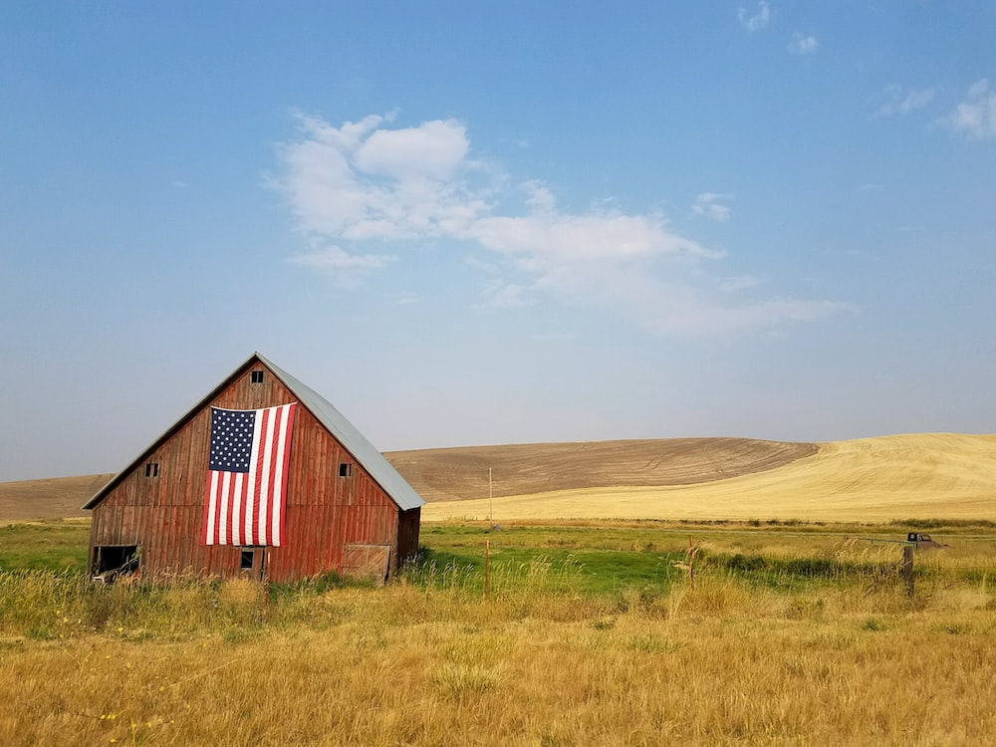
God Bless America
Irving Berlin / Arr. Lisa Nelson
Notes:
Cue the next slide when Tim says, “Please stand and join us in singing…”

Slide 64
God bless America,
Land that I love

Slide 65
Stand beside her and guide her,

Slide 66
Through the night with the light from above.

Slide 67
From the mountains, to the prairies,

Slide 68
To the ocean, white with foam

Slide 69
God bless America, my home sweet home
Notes:
Move to next slide after the last word is sung

Slide 70
God bless America, my home sweet home
©Irving Berlin Music Company
Notes:
Move to next slide after final “home.”

Slide 71
Notes:
Cue next slide after applause is done.

Slide 72

Blessed Be the Name of the Lord
Clinton Utterbach / Arr. Lisa Nelson
Notes:
Move to final slide after the applause.

Slide 73

The Stars & Stripes Forever
John Philip Sousa / Arr. Phil Norris
Notes:
Move to final slide after the applause.

Slide 74

Joyful, Joyful, We Adore Thee
Ludwig Van Beethoven / Arr. Tim Zimmerman
Notes:
Move to final slide after the applause.

Slide 75
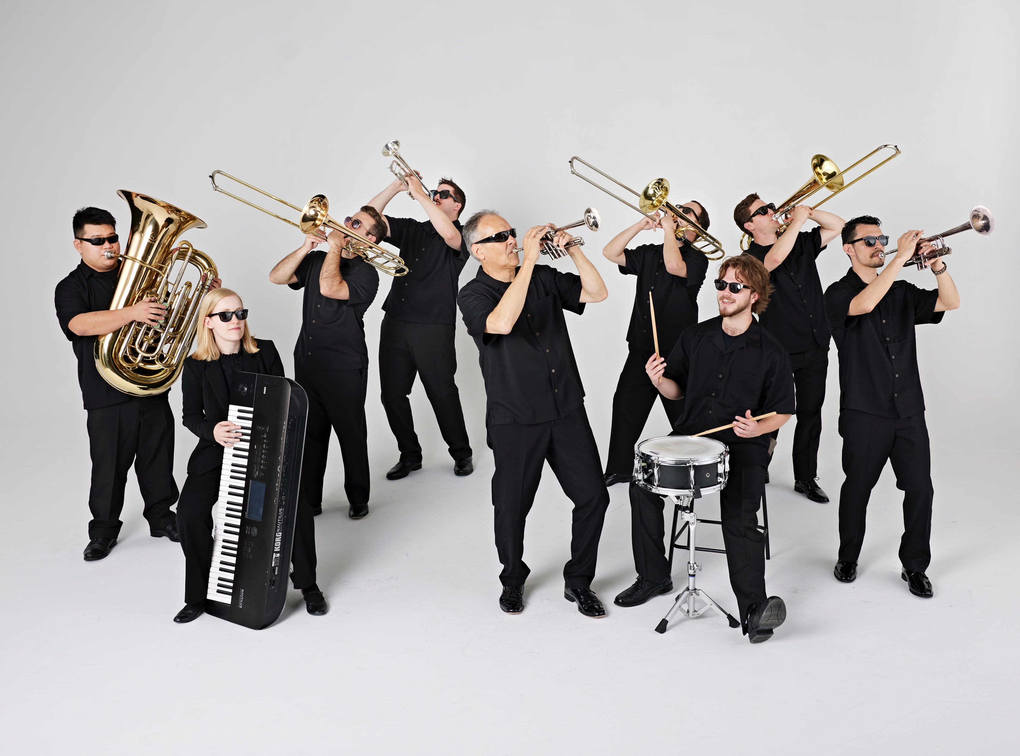
Tim Zimmerman &
The King’s Brass
Notes:
Leave here for remainder of concert. No slides needed for any encore pieces we play. Thanks!

